Slide 1
Benefits to South African research of SAFIRE's eduGAIN membership
eResearch Africa 2017 University of Cape Town, May 2017

Slide 2
Identity Federations
A brief introduction

Slide 3
Federated Identity
A federated identity in information technology is the means of linking a person's electronic identity and attributes, stored across multiple distinct identity management systems
https://en.wikipedia.org/wiki/Federated_identity
Notes:
Explain the concepts of identity, attributes, and identity management systems

Slide 4
The problem we’re trying to solve

Slide 5



Why not just use Google?
All the major social network platforms provide federated identities…
… so why don’t we just use these?
They all have one major drawback – they are self asserted
This means you cannot trust any of the attributes
This is often okay, but…
donald.trump17@gmail.com
Notes:
Would you allow Donald.trump17@gmail.com access to sensitive medical records?

Slide 6
Academic Identity Federations
Academic identity federations exist to solve the trust problem
Your home organisation – university, research council, etc – knows a lot about you
They also know stuff specific to higher education (HEMIS, RIMS)
More importantly, most of this information has usually been checked and may be subject to audit
This makes them ideal to act as identity providers

Slide 7
Academic Federation Operators
All federations have operators
Facebook Inc operates Facebook Connect
Academic federations
Usually operated by the National Research and Education Network (NREN)
Typically only one per country
65 known academic federations worldwide

Slide 8

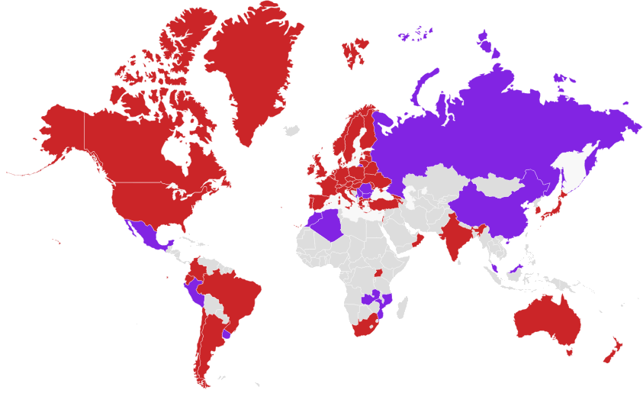
Academic Identity Federations Around the World
https://refeds.org/federations/federations-map, May 2017

Slide 9
Academic Federation Operators
Academic federations are primarily trust relationships with federation operators acting as trusted introducers
Federation operators worldwide collaborate on issues of interest to the research & education
Interoperability (R&S profile)
Common identifiers (eduPersonOrcid)
Handling of sensitive information
Security/incident response (SIRTFI)
etc…
Notes:
https://refeds.org/category/research-and-scholarship
https://refeds.org/sirtfi

Slide 10

Inter-federation
Inter-federation is the linking of one (academic) federation to another
Through inter-federation we can gain access to services that are not yet available in our own country
Service providers can gain access to customers

Slide 11
SAFIRE
South African Identity Federation

Slide 12
SAFIRE – South African Identity Federation
Academic identity federation for South Africa
Conceived by the community and piloted over a number of years
Supported service operated by TENET
Current identity providers:
CSIR, NMMU, NWU, SUN, UCT, UWC…
Member of eduGAIN (since February)
48th member / 41st full participant
1st member in Africa

Slide 13
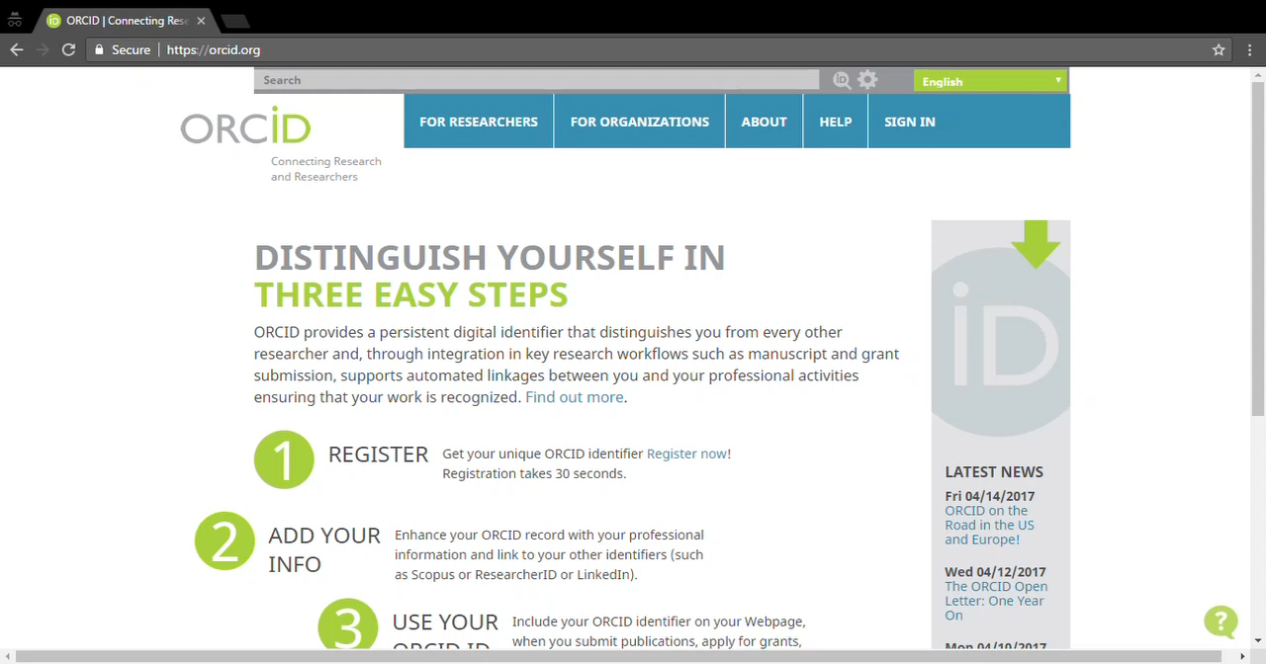
live demo?

Slide 14
So what does this all mean for R&E?

Slide 15

One ring identity to rule them all
Source: http://lotr.wikia.com
Notes:
This is probably the ultimate goal of federation, but also an unrealistic one. “fewer identities” is probably more realistic.

Slide 16
For identity providers
Simplified integration = lower costs
Reuse of existing identity information
Standardised attribute release
The hub also helps by adding missing attributes
Mandatory consent
Helps with POPI/privacy legislation
Things university management / IT departments care about, not researchers…
Notes:
https://learn.nsrc.org/fedidm/idfed

Slide 17
For service providers
Access to existing, high quality identity information
Reduced support costs
Password problems go to the IdP’s help desk
Helps comply with privacy and identity laws
Less personal info = reduced risk
Access is revoked when people leave
Improved user experience – easier for people to get started using your service
Things CIOs / IT managers care about, not academics…
Notes:
https://learn.nsrc.org/fedidm/service_providers

Slide 18
For libraries
Provides a new approach to electronic resource management
Better control over who has access to your resources = better compliance with licensing agreements
Allows you to downsize/decommission reverse proxies
Deals with the burgeoning SSL subject alternative name problem
Less confusing for your users
Things library directors care about…

Slide 19

For academic & research staff
Immediate access to a wide range of existing global services via eduGAIN
One username and password to remember
Better control over your personal info
Fosters (global) collaboration
Allows you to forget about identity and focus on research (& teaching)…
But don’t take my word for it…
Notes:
https://learn.nsrc.org/fedidm/iam_researchers

Slide 20
FIM4R Findings (2012)
Federated technologies are good. Take advantage of them.
The infrastructure needs to be improved to take advantage of federated technologies. Do it.
Relying on older models of local account creation and IP-based ACLs is easier. This is a very limited view. Stop it.
If you can’t fix it all yourself (and you can’t), facilitate the efforts of groups that can. Build relationships, target your spending or funding to make the biggest impact.
Source: http://cds.cern.ch/record/1442597 Via: https://learn.nsrc.org/fedidm/iam_researchers
Notes:
FIM4R is the Federated Identity Management for Researchers working group, comprising researchers from large science projects like CERN, Science & Technology Facilities Council (UK), European Bioinformatics Group, etc. They published findings in 2012, which are summarised on this page. Heather Flannigan expands on them at https://learn.nsrc.org/fedidm/iam_researchers

Slide 21
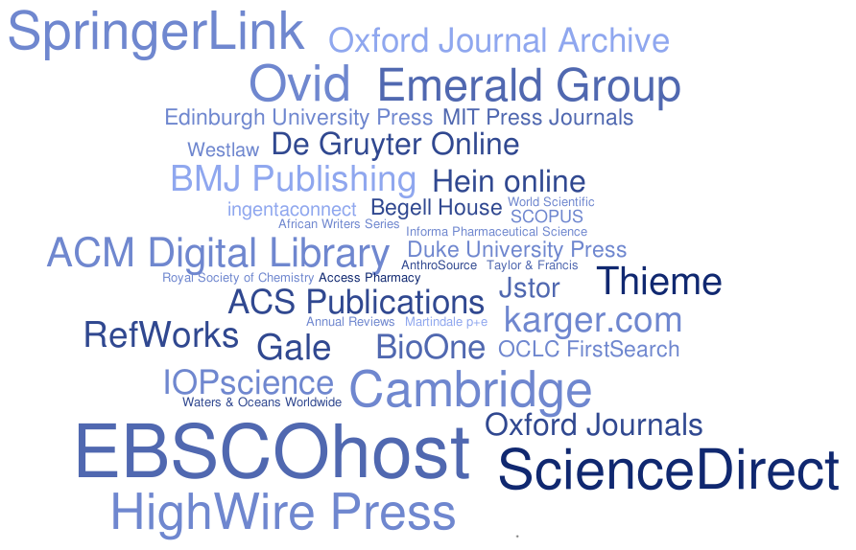
Questions?
Rhodes University Library & eduGAIN MET
Notes:
Tag cloud shows frequency (number of federations) of various academic publishers in eduGAIN metadata

